Slide 1
Are You Mentally Tough Enough?
Use the GMTSS to Teach, Train and Retain

Slide 2
What are you going to do get there?
Local Seminars (Scheduled)
UPB’s
District Convention
International Convention
World Conference
NUOT, B5, ECCT
Product Trainings

Slide 3
Consistency and Leadership

Slide 4
Consistency and Routines
Can’t start and stop
Show up
Don’t let life get in the way of living
Give it your all for two to three years
Do it right!

Slide 5
Commitment
and
Discipline

Slide 6
Add Two Possibilities
Call One
Show One Business Plan

Slide 7
Show me your routines, habits and rituals and I’ll show you your future…..

Slide 8
You have to
“DO SOMETHING”

Slide 9
When?
The time will never be right!
You will always be too busy!
Money will always be tight!
Someone will always be negative!
There will always be something that looks easier or promises you that you don’t have to do any work.
The economy will always be up and down.

Slide 10
A Business of Inconvenience
It’s easier not to talk to people
It’s easier not to listen to audios
It’s easier not to write a goal statement
It’s easier not to make the phone calls
It’s easier not to come to the seminars
It’s easier to miss the UBP’s
It’s easier to watch TV every night
It’s easier to be broke

Slide 11
You need to be inconvenient for 2 to 3 years to be convenient the rest of your life

Slide 12
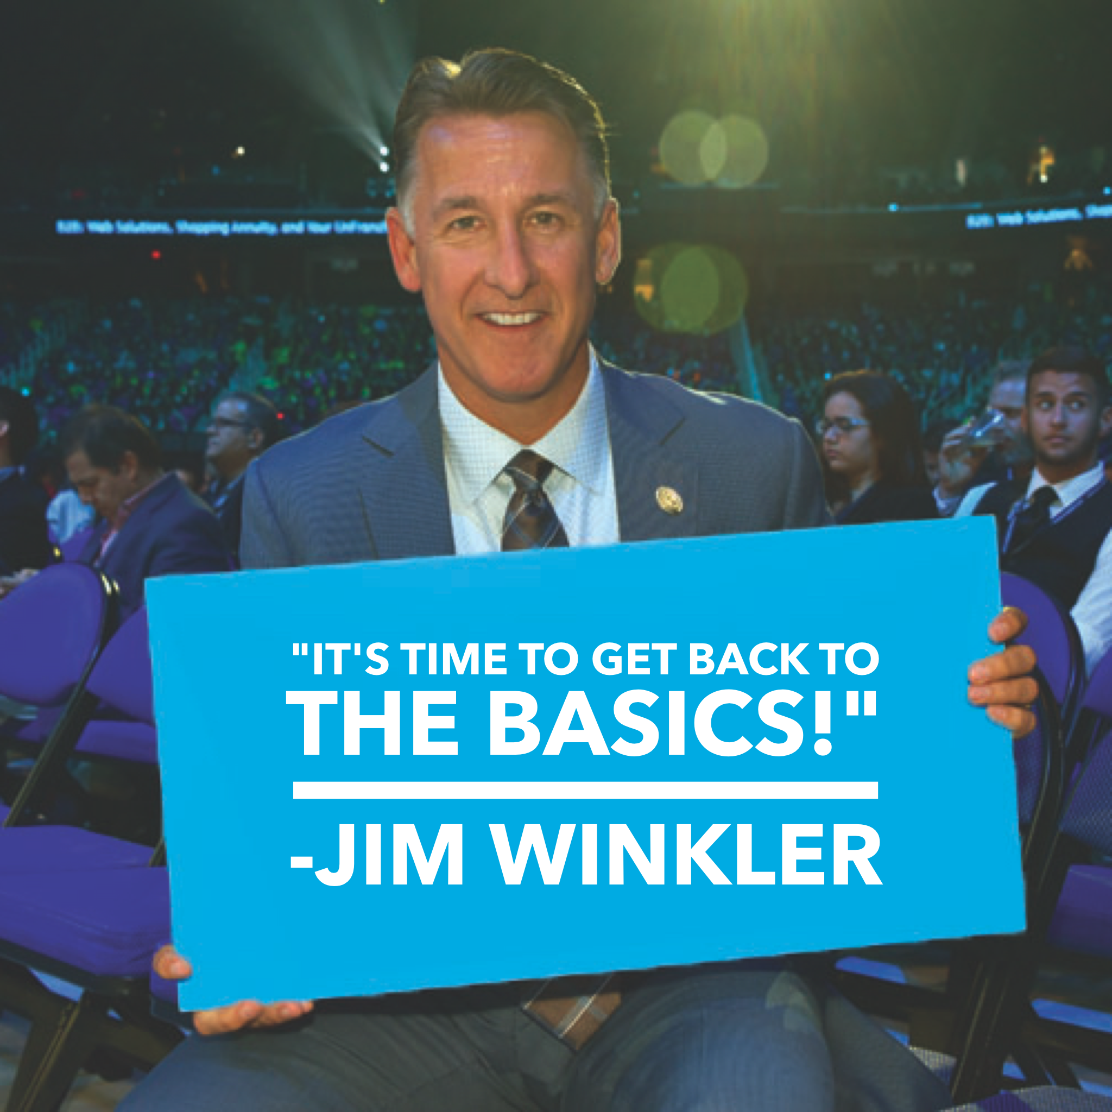

Slide 13
Result Producing Activities
Show the plan
Use and share the products
Sell tickets
Build in the homes
Shopping Annuity Master Member
Master UnFranchise Owner

Slide 14
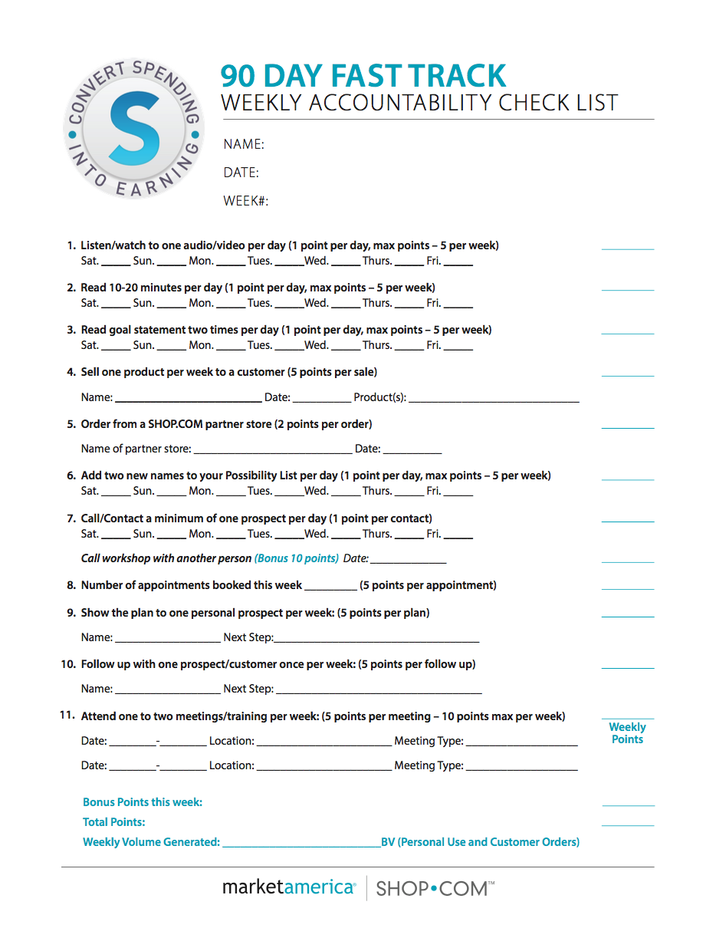

Slide 15
#1 Reason that people don’t succeed
Excuses

Slide 16
#2 Reason that people don’t succeed
More Excuses

Slide 17
#3 Reason that people don’t succeed
Constant Excuses!

Slide 18
Eight Audios/Books
Failing Forward John Maxwell
The 21 Irrefutable Laws of Leadership John Maxwell
Rich Dad, Poor Dad Robert Kiyosaki
Cash Flow Quadrant Robert Kiyosaki
Go Pro Eric Worre
Building an Empire Brian Carruthers
The Slight Edge Jeff Olson
Lower Your Taxes Big Time Sandy Botkin

Slide 19
Sometimes…
We have doubts
It is harder than we thought
Someone on our team quits
What if it doesn’t work for me
My people don’t listen
My people don’t do anything!
It’s not going fast enough

Slide 21
Some People Will…
Decide to take a break
Slow Down
Start hanging around negative people
Stop attending any trainings and meetings
Start making excuses
Settle for a life they don’t want

Slide 22
Ten Years from
now they will still be
complaining about
the same things in life!
Telling everyone how they
can’t get a break…

Slide 23
Some People Will…
Renew their commitment
Decide to try twice as hard
Read better books – listen to better audio tapes – GROW!
Do Simple RPA’s everyday
Hang around positive people
Attend every training and meeting
Decide to never give up

Slide 24
Some People Will…
Take constructive criticism
Measure, monitor and change course
Take personal responsibility
Work harder, care deeper, and help more people
Strive instead of settle…

Slide 25
Ten Years from
now they will live the life that they have always dreamed of!
Still everyone will say,
that they got lucky…

Slide 26
Leadership
Your long term income will be determined by the example that you set and the things you do

Slide 27
Gaming Issues and Manipulation of the MPCP
Retail (Reseller) establishments
Sales/Auction websites (i.e. Amazon, Ebay, Yahoo, Shoppee, Taobao, etc.)
Countries Market America’s UFOs are not authorised/licensed to sell direct
People going into other UFO’s UnFranchise.com (back office) and filing fraudulent Form 1000’s or placing orders

Slide 28
These POLICIES, RULES, REGULATIONS have been in place for 26 years:
To maintain a level playing field for all UFOs
To protect/maintain competitive suggested retail price
To protect our brand
To protect the UnFranchise® Business

Slide 29
What is required to Perpetrate the Violations
One or more common third party “ship to address” locations as shipping and handling collection points/hubs for transfer to a reseller (Auction Sites or Unauthorised country)

Slide 30
Violation of these prohibited activities/practices by Individual UFOs or Teams of UFOs have resulted in:
Prices driven lower and lower as more Violating UFOs use Auction Sites and Resellers to “Beat the System”
Difficulty in selling products at SRP or even a profit
Difficulty in keeping repeat customer base
Frustrating and demotivating UFOs across every line of sponsorship

Slide 31
Don’t Be A Boss
Most people already have one boss that they don’t like. Be a servant leader – prove that you want to help them and do the activities to back that up.

Slide 32
You don’t manage people. You lead people and you manage things
How do you become a great leader or income earner?
By doing the things that you expect your group to do

Slide 33
Are you a Leader?
Leaders do not create followers, they create new LEADERS!
A leader is someone who demonstrates what is possible

Slide 34
Leaders
Work with people at the level they are at
Good listening skills
Empathy (but don’t commiserate)
Problem Solving Skills (I hear you and understand but how can we make this work for you) The more problems you solve the more money you will make
Caring
Integrity
Always learning
Lead by example

Slide 35
Benefits of Business Growth
More friends
More family
Better health
Sense of purpose
Options in life
Security
Personal Growth

Slide 36
It’s Worth It!

